Slide 1

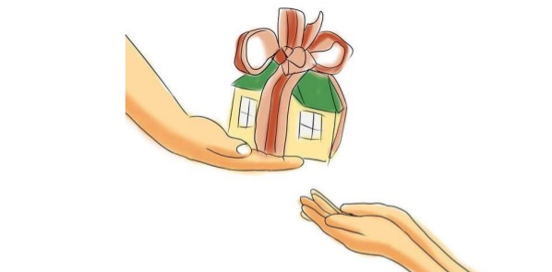
Inheritance

Slide 2
Introduction
Inheritance is the backbone of object-oriented programming (OOP).
It is the mechanism by which a class can acquire properties and methods of another class.
Using inheritance, an already tested and debugged class program can be reused for some other application.

Slide 3
Introduction
Super class This is the existing class from which another class, that is, the subclass is generally derived.
In Java, several derived classes can have the same super class.
Subclass A class that is derived from another class is called subclass.
In Java, a subclass can have only one super class.

Slide 4
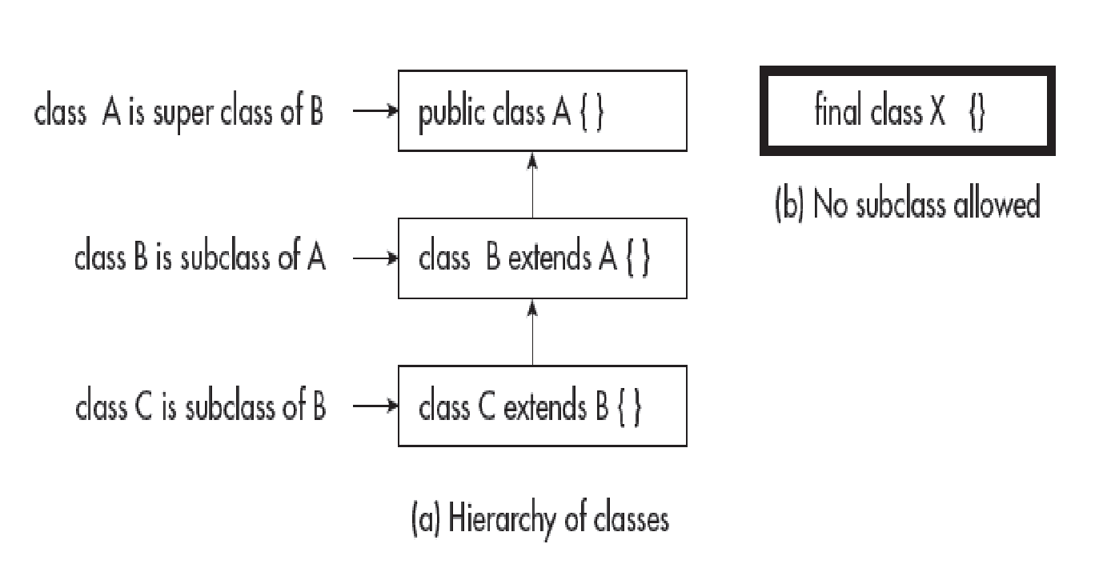
Inheritance

Slide 5
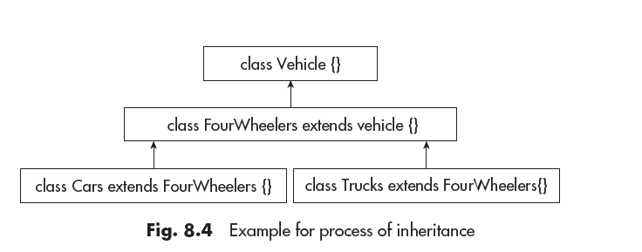
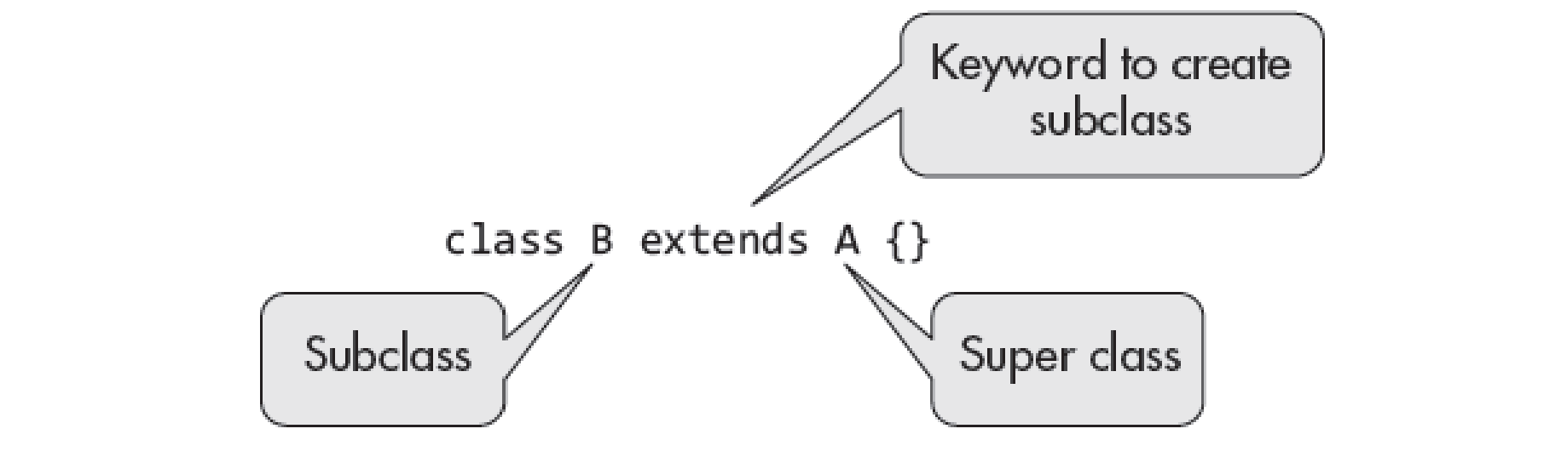
Process of Inheritance

Slide 6
Types of Inheritance
The following types of inheritances are supported by Java.
1. Single inheritance
2. Multilevel inheritance
3. Hierarchical inheritance
4. Multiple inheritance using interfaces

Slide 7
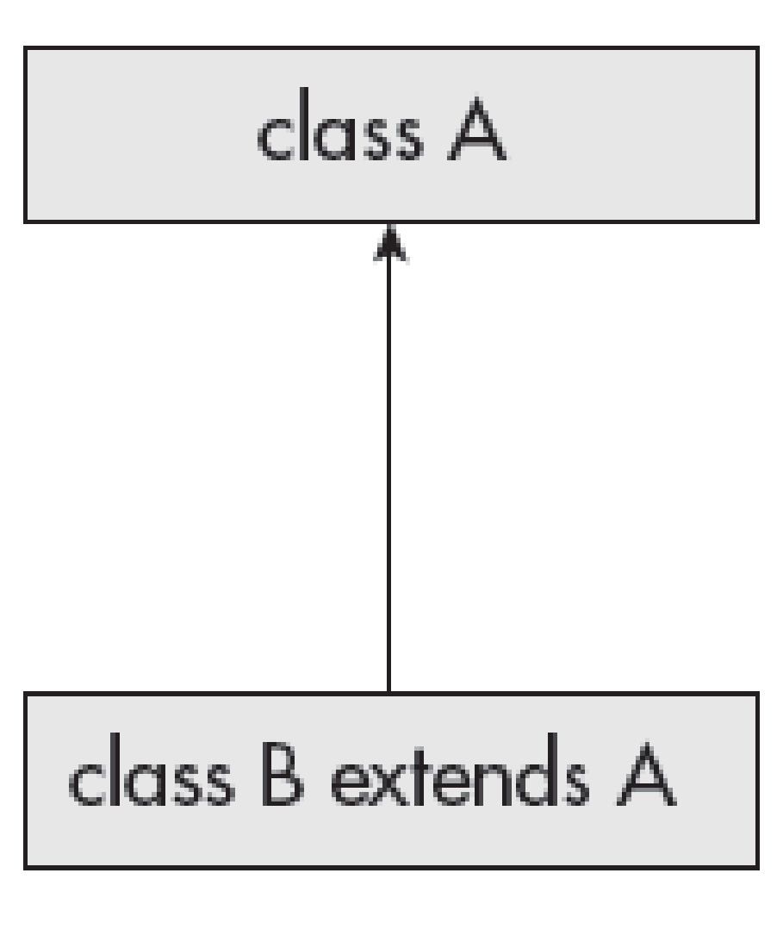
Types of Inheritance
Single inheritance: It is the simple type of inheritance. In this, a class extends another one class only.

Slide 8
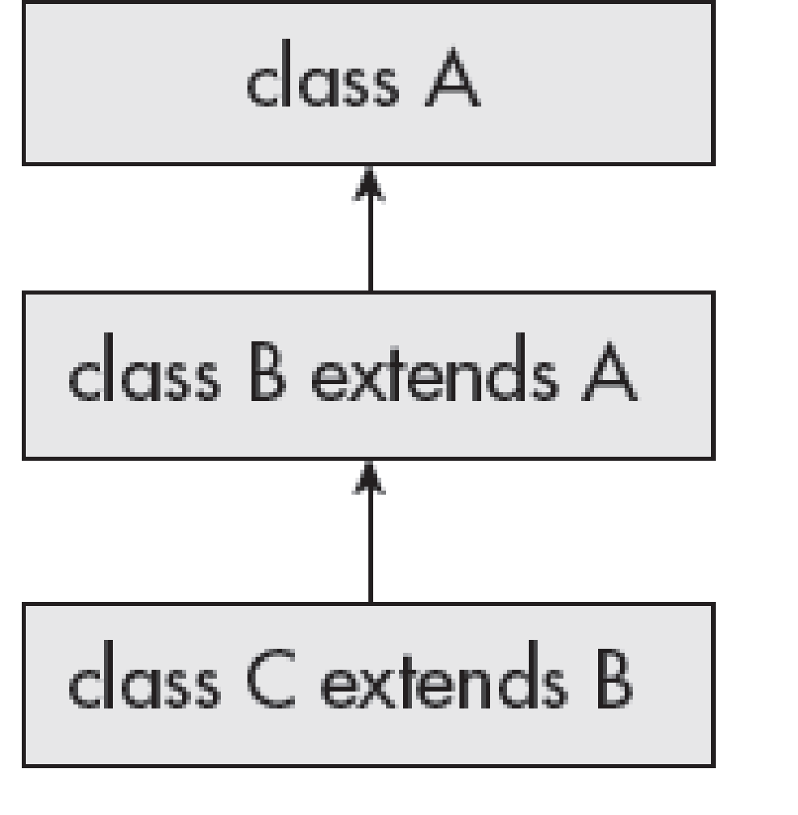
Types of Inheritance
(ii) Multilevel inheritance: In this type, a derived class inherits a parent
or super class;
The derived class also acts as the parent class to other class.

Slide 9
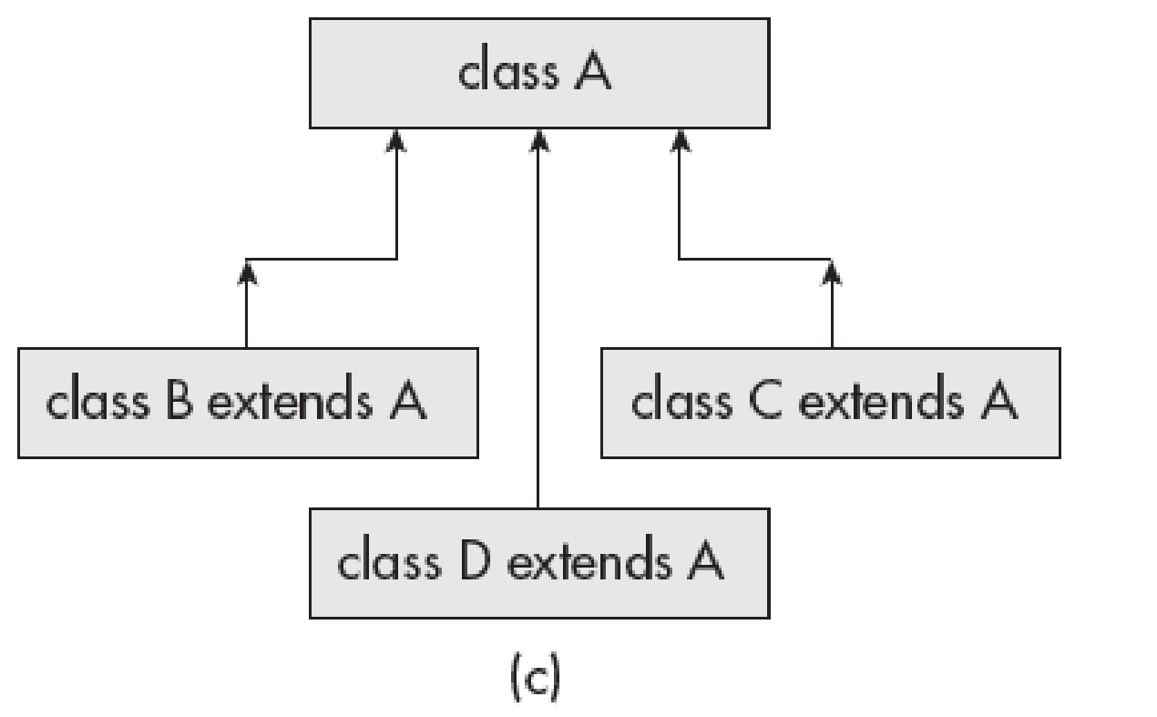
Types of Inheritance
Hierarchical inheritance: In this type, one class is inherited by many sub classes.

Slide 10
Types of Inheritance
Multiple inheritance: In this, a class is extending more than one class.
Java does not support multiple inheritance through classes.
This implies that a class cannot extend more than one class.
Suppose there is a method in class A. This method is overridden in class B and class C in their own way.
Since class C extends both the classes A and B.
So, if class C uses the same method, then there will be ambiguity as which method is called.
We can implement the multiple inheritance in java by using the Interface

Slide 11
Universal Super Class—Object Class
Object class is a special class and it is at the top of the class hierarchy tree.
It is the parent class or super class of all in Java.
Hence, it is called Universal super class.
Object is at the root of the tree and every other class can be directly or indirectly derived from the Object class.

Slide 12
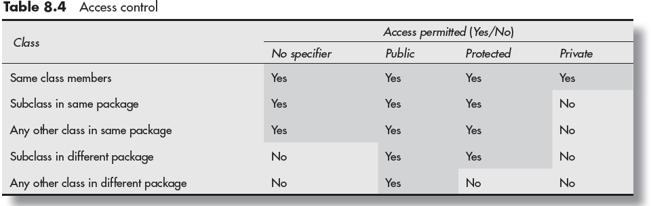
Access Control and Inheritance

